Slide 1
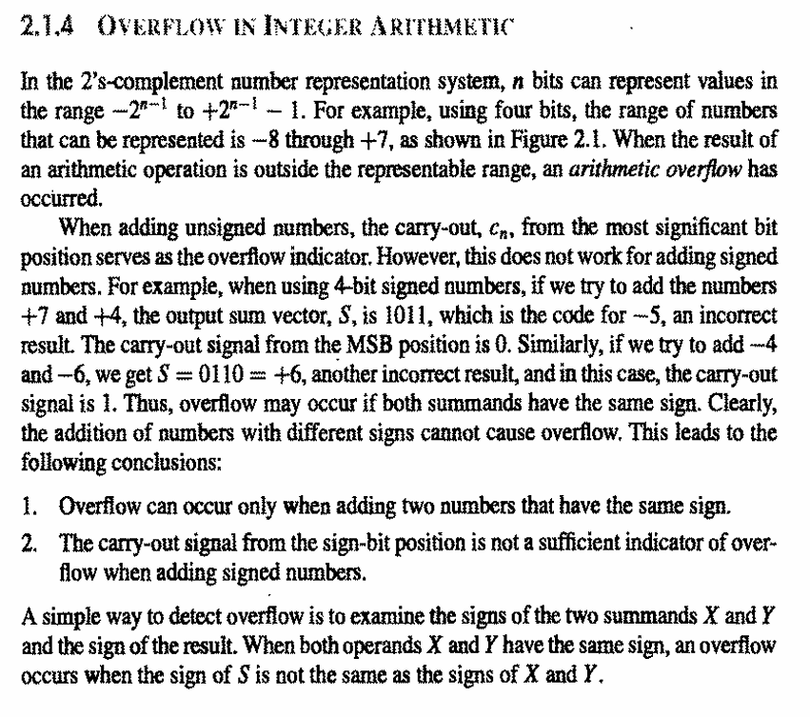
Pg 49

Slide 2
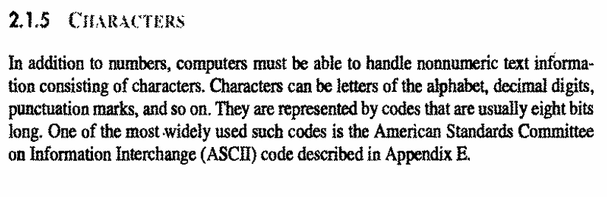
Pg 50

Slide 3
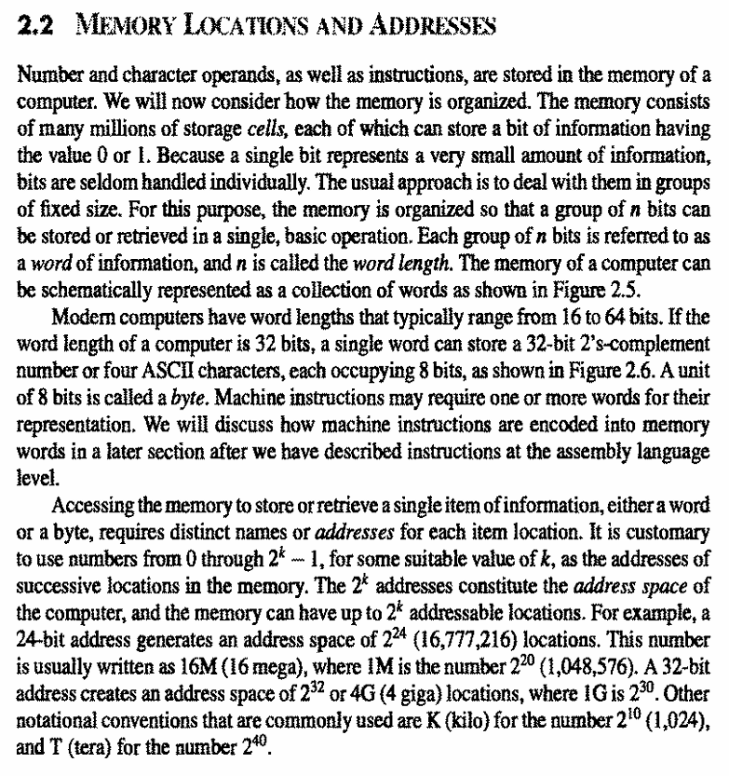
Pg 50

Slide 4
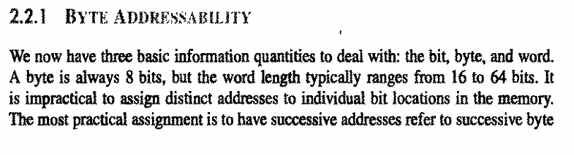
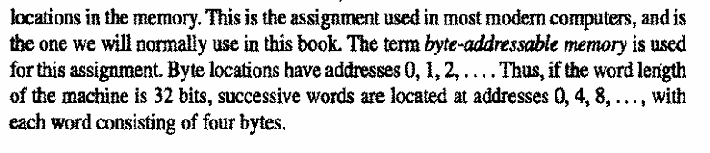
Pg 51

Slide 5
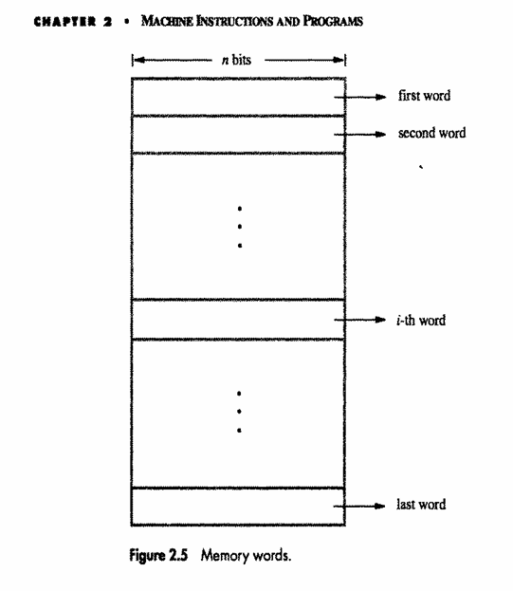
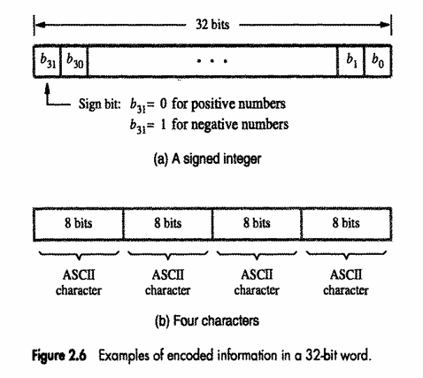
Pg 49

Slide 6
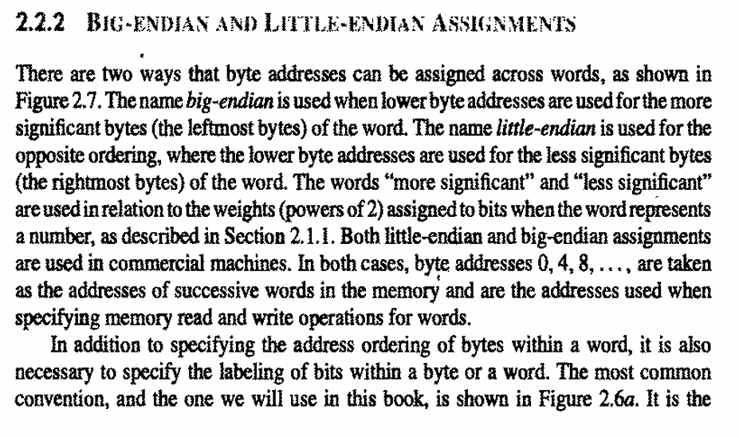
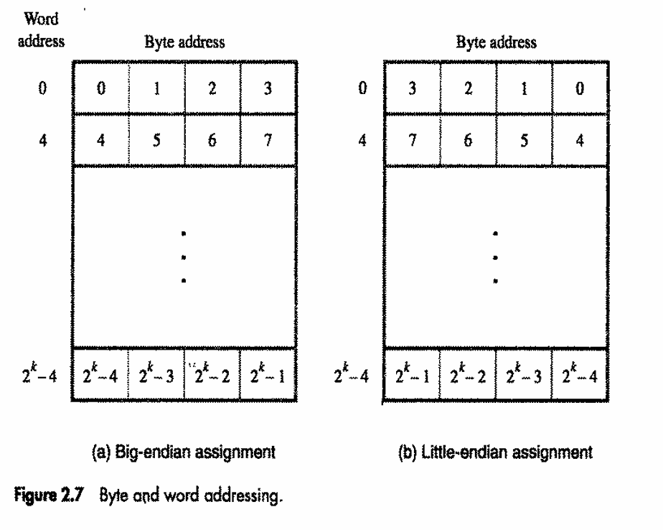
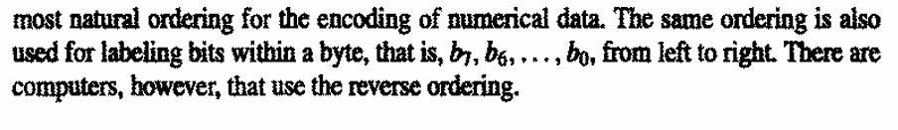
Pg 52

Slide 7
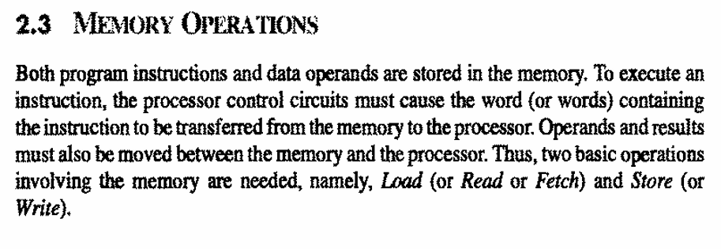
Pg 54

Slide 8
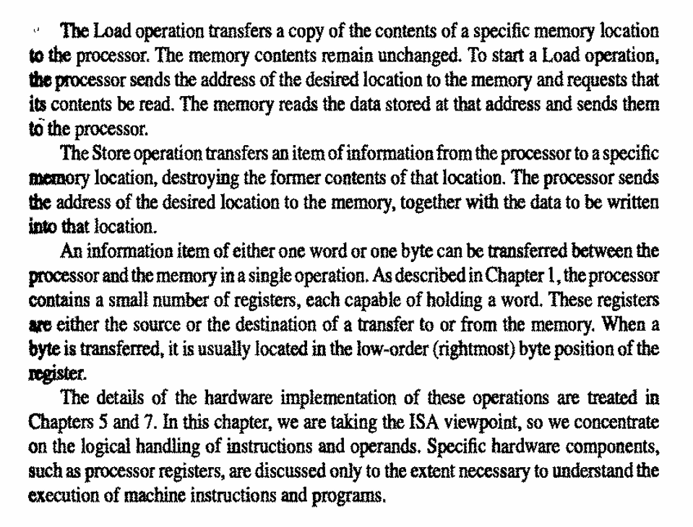
Pg 49

Slide 9
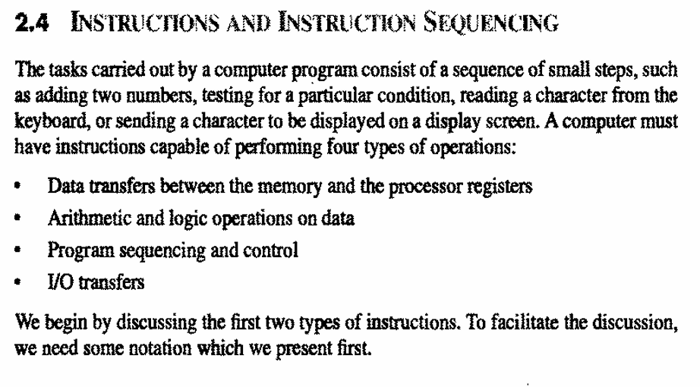
Pg 49

Slide 10
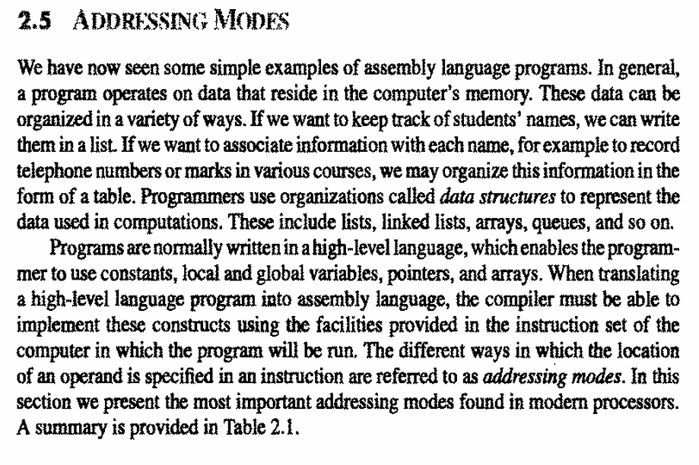
Pg 65

Slide 11
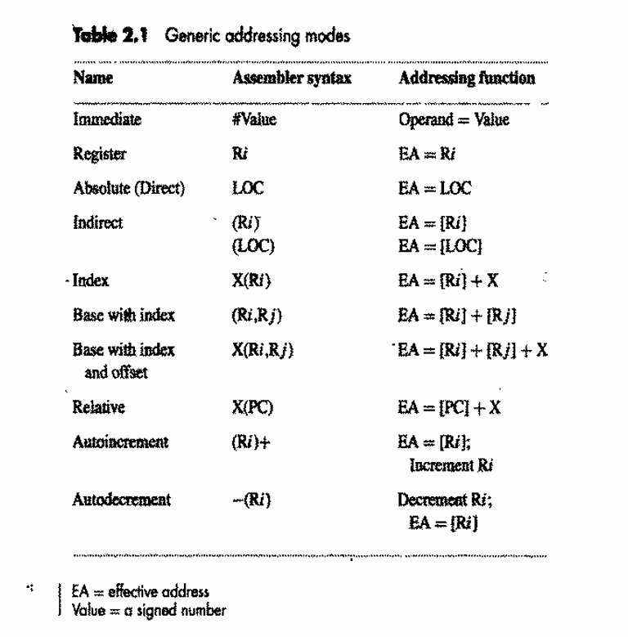

Slide 12
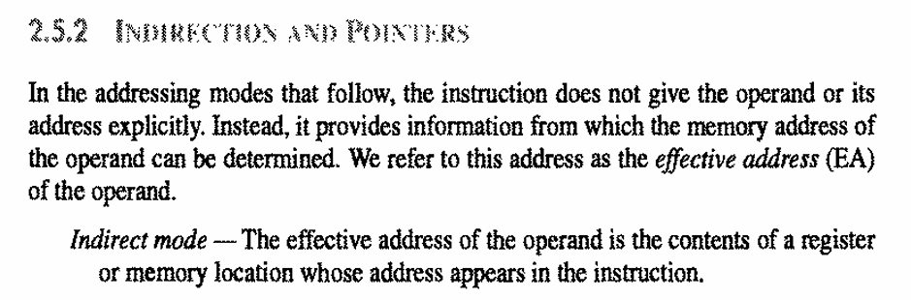

Slide 13
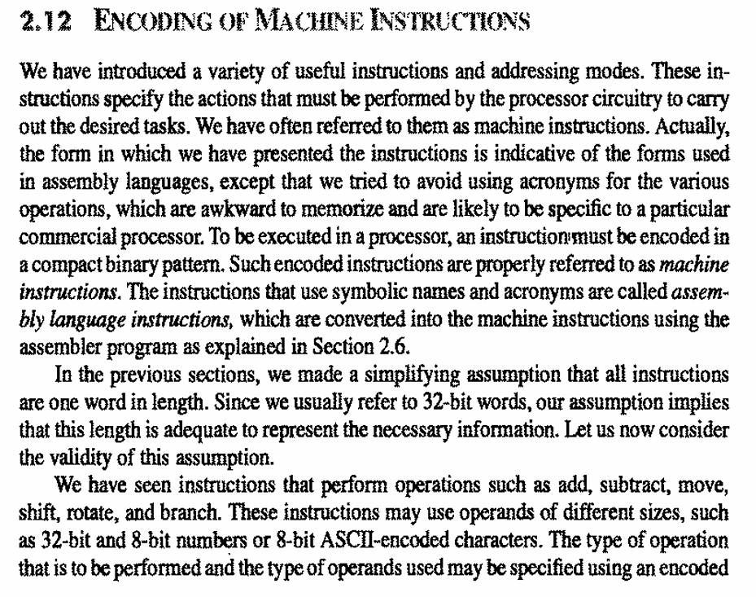

Slide 14
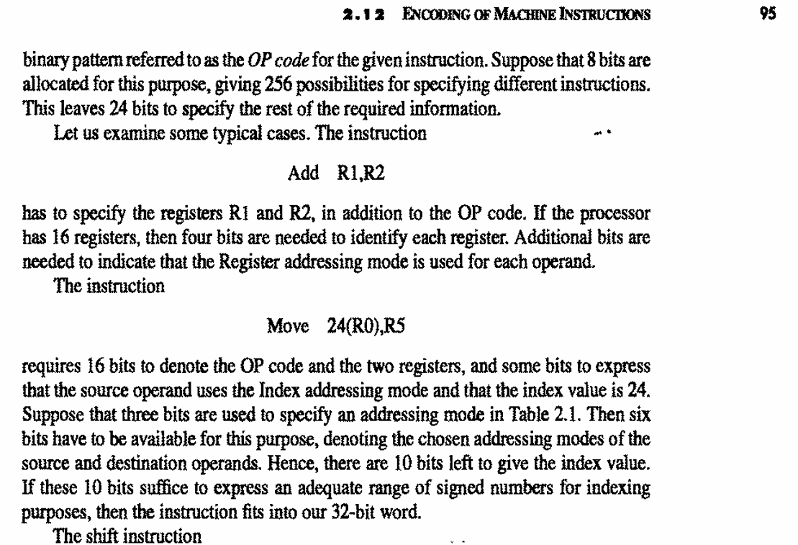

Slide 15
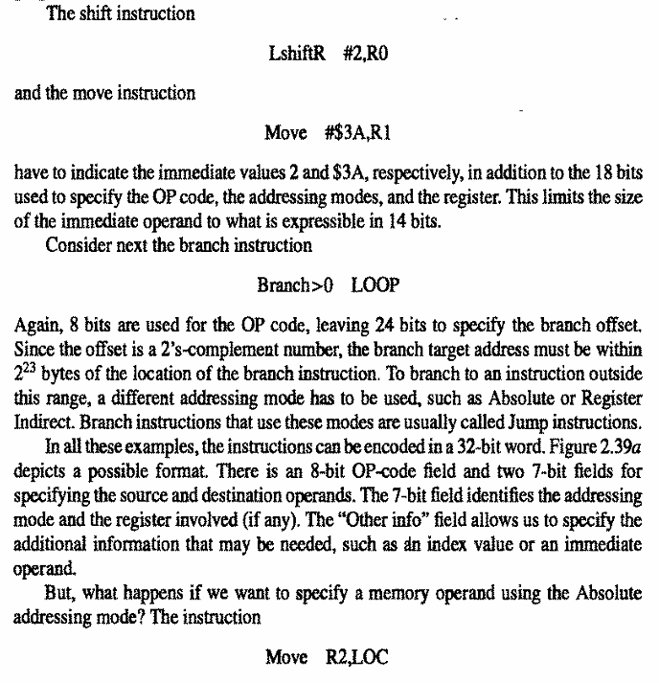

Slide 16
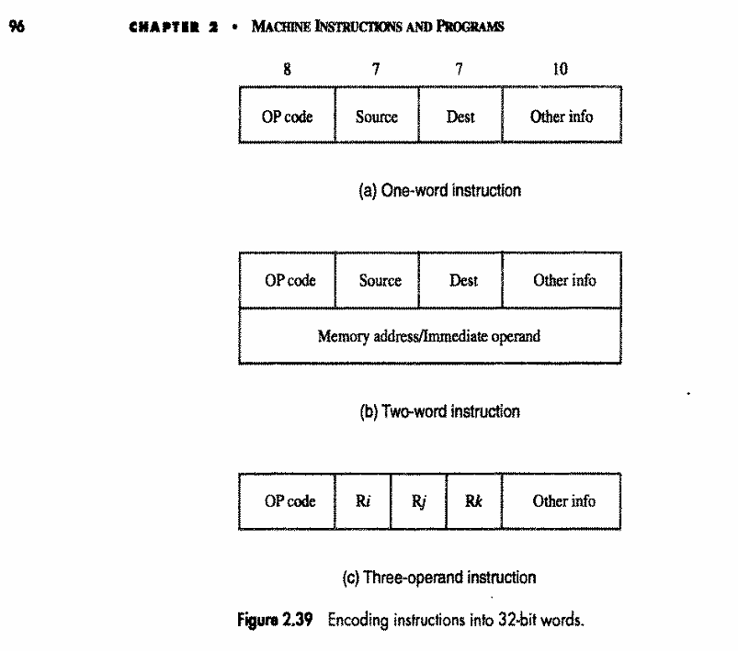

Slide 17
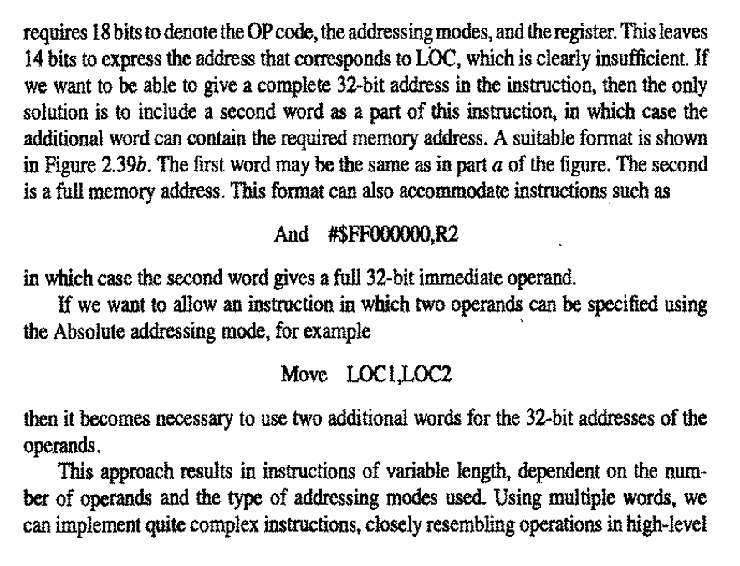

Slide 18
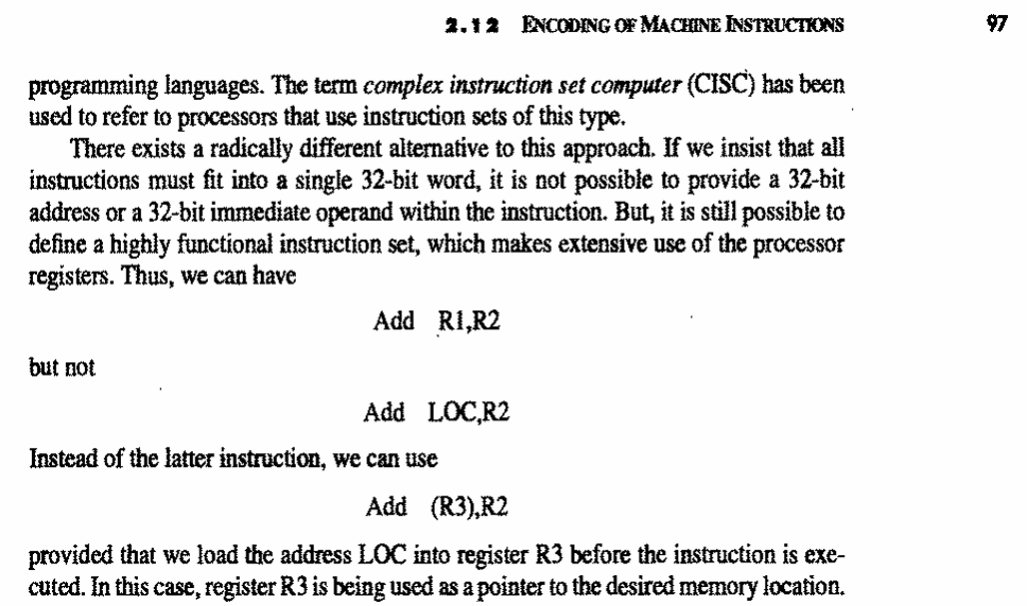

Slide 19
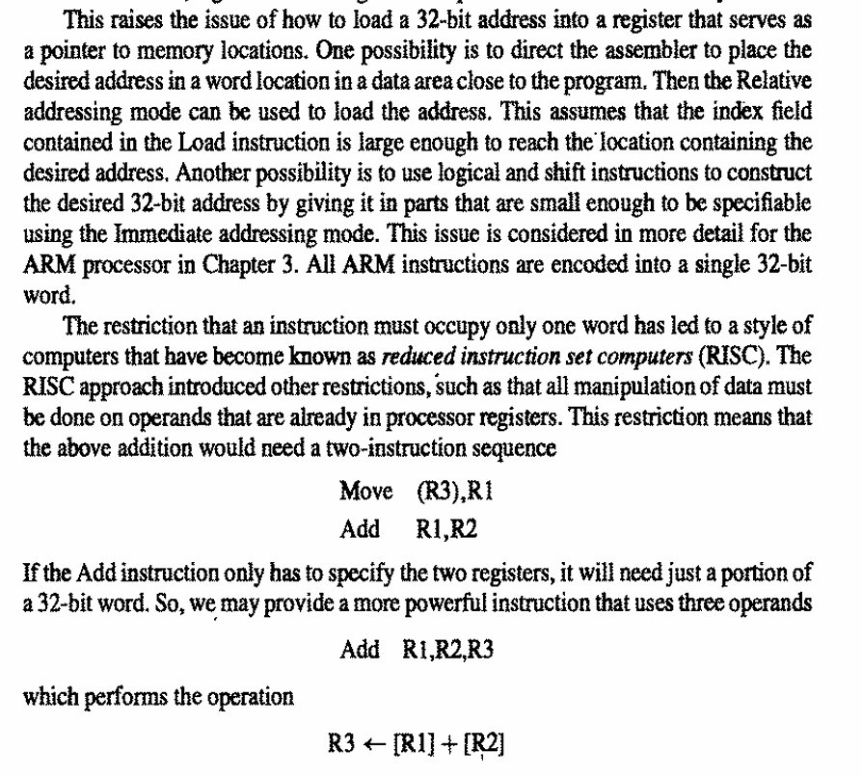

Slide 20
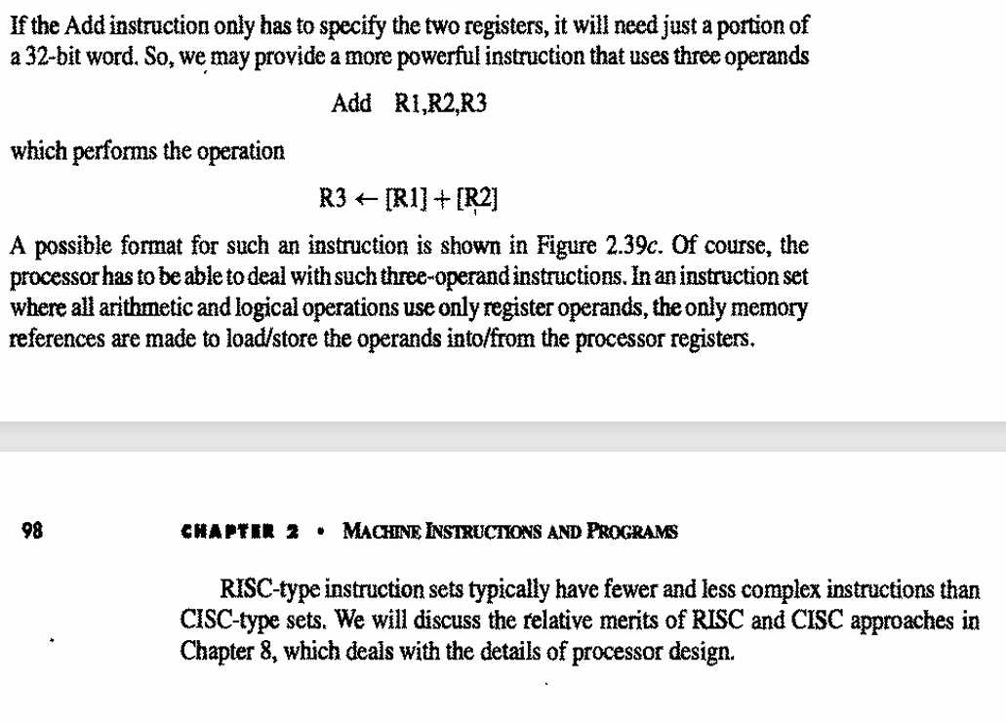

Slide 21
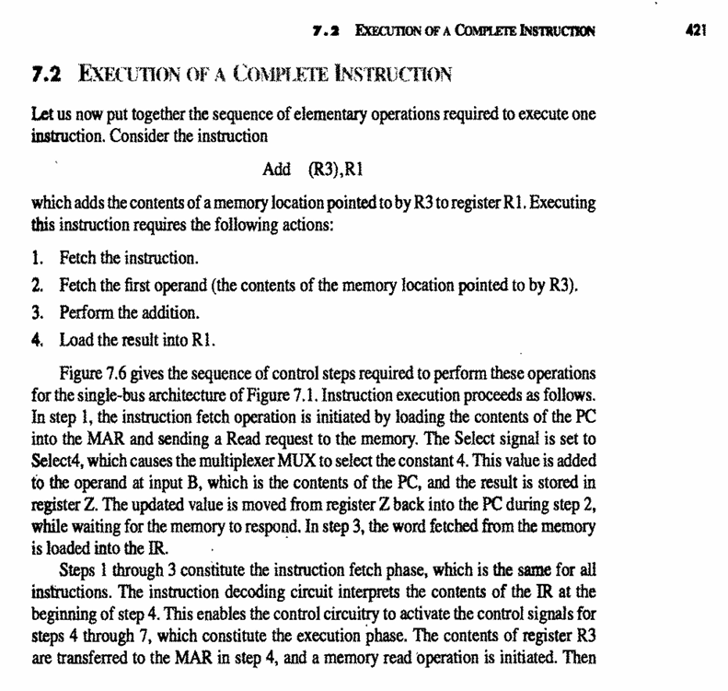
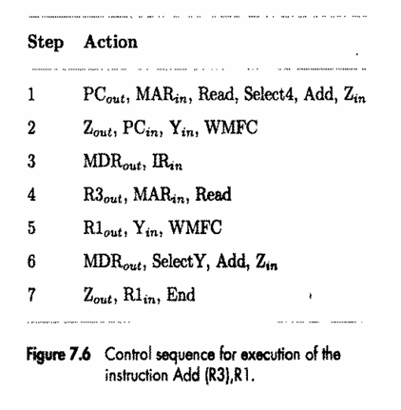

Slide 22
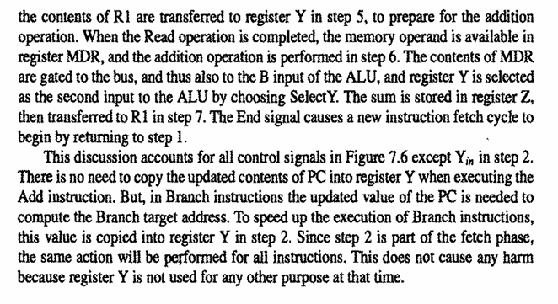

Slide 23
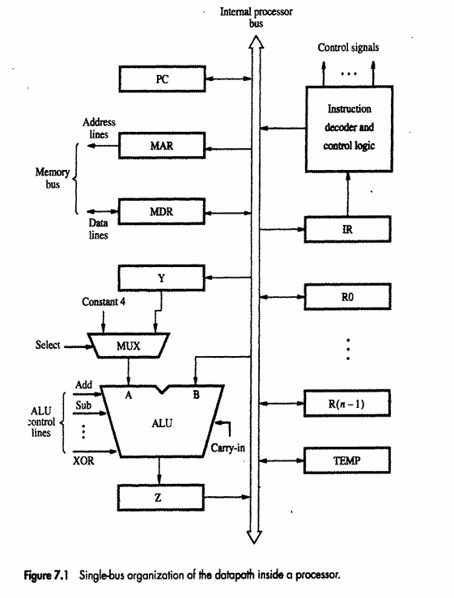

Slide 25
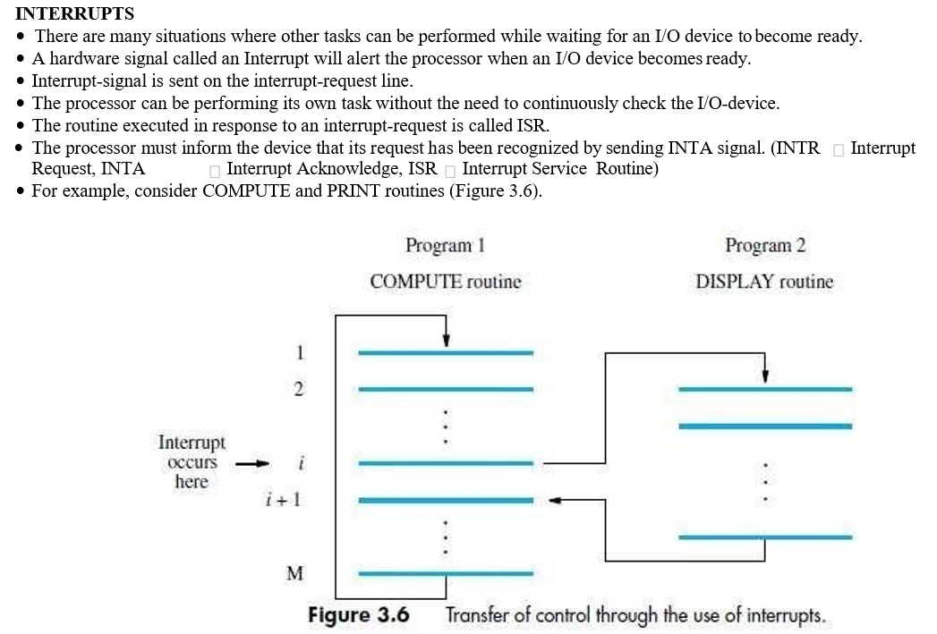

Slide 26
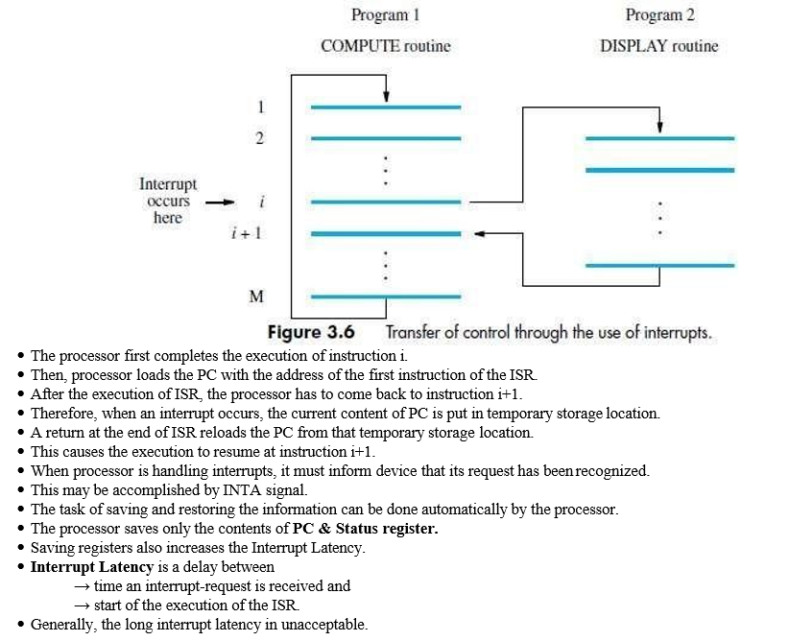

Slide 27
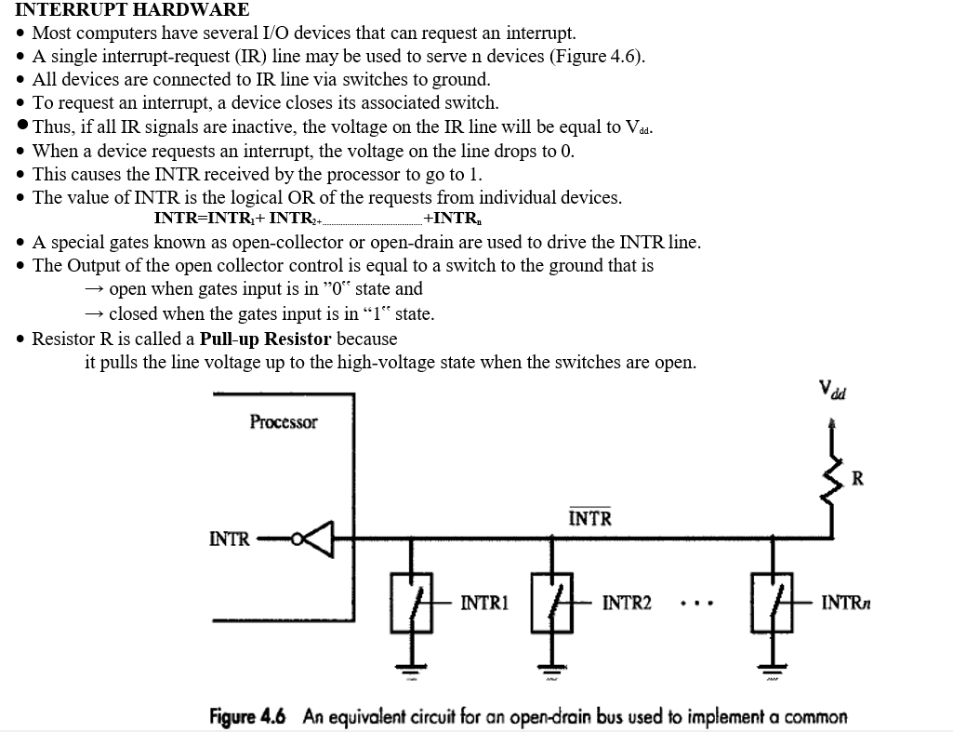

Slide 28
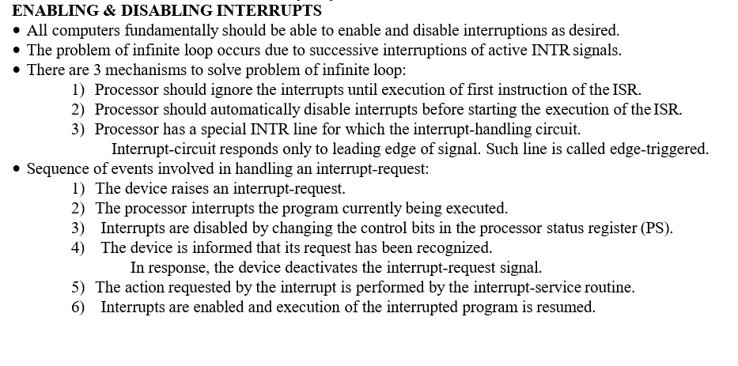

Slide 30
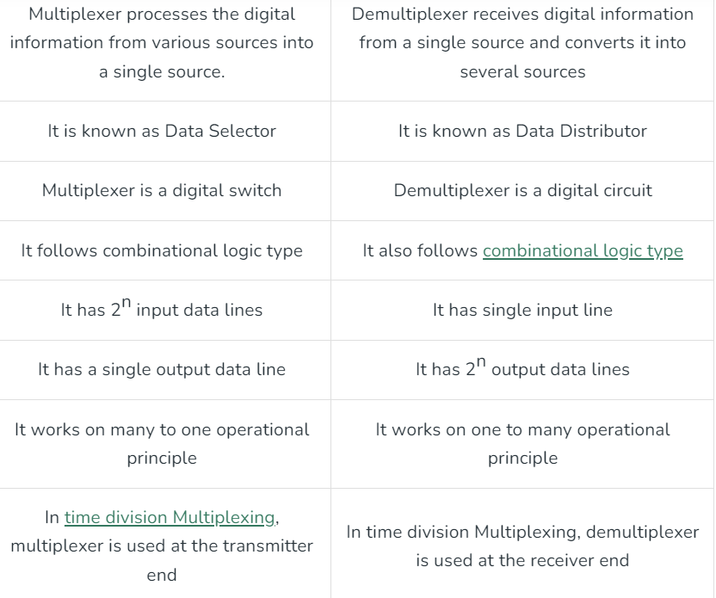

Slide 31
Applications of MUX
MUX i.e., multiplexer has many applications in different fields. Some of these applications are listed below.
Implementation of Digital Circuits
Control Unit of CPU
Parallel to Serial Data Conversion
Computer Memory
Data Routing
Communication Systems

Slide 32
Applications of DEMUX
DEMUXs are majorly used to design the ALU circuits and parallel data segments.
The DEMUXs convert the output of the MUX into the actual input. On the receiver end, the DEMUX can be used to verify the original form of the data to carry out the entire communication process.
DEMUX helps to save the output. The output generally saved to the ALU. The output will be saved in the registers and the various storage units of the system.
Each DEMUX has a connection with multiple registers which helps to store the processed data into it.
The counterpart of the DEMUX regulates the data signal at the output stage of the DEMUX operation. These data can be retrieved later to read out parallelly.
In the audio or video system, the DEMUX distributes them in different channels. In broadcasting, the DEMUX separates the composite signal into an individual one.

Slide 33
Application of counters
Frequency counters
Digital clock
Time measurement
A to D converter
Frequency divider circuits
Digital triangular wave generator.

Slide 34
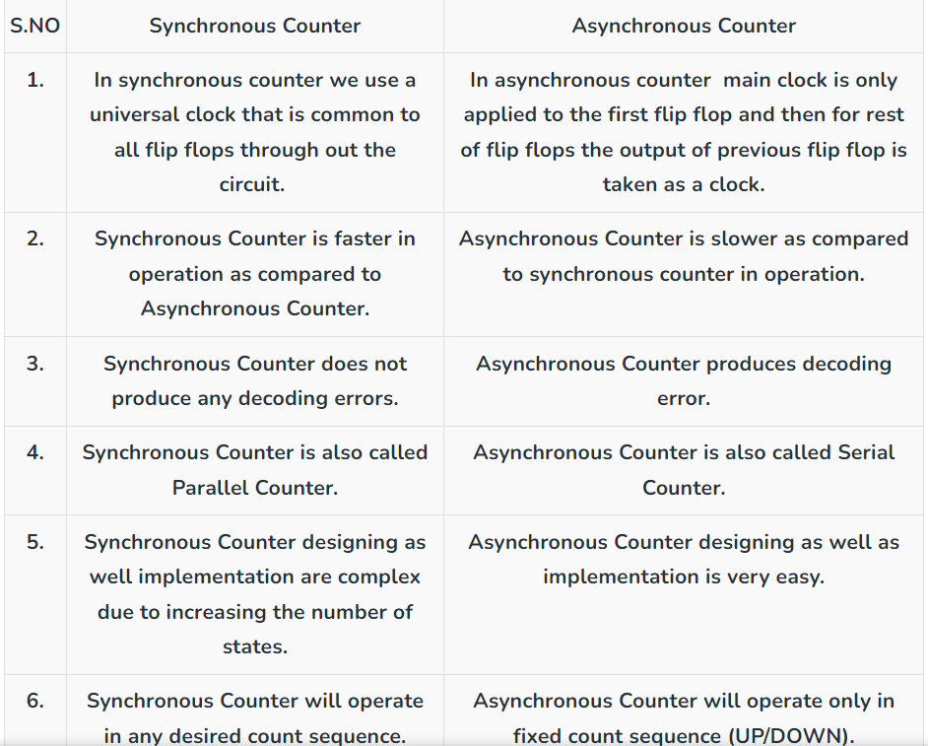

Slide 35
T-FF Applications:
Counters: T Flip Flops used in counters. Counters counts the number of events that occurs in a digital system.
Data Storage: T Flip Flops used to create memory which are used to store data, when the power is turned off.
Synchronous logic circuits: T flip-flops can be used to implement synchronous logic circuits, which are circuits that perform operations on binary data based on a clock signal. By synchronizing the logic circuit’s operations to the clock signal using T flip-flops, the circuit’s behavior can be made predictable and reliable.
Frequency division: It is used to divide the frequency of a clock signal by 2. Flip-flop will toggle its output every time the clock signal transitions from high to low or low to high, hence dividing the clock frequency by 2.
Shift registers: T flip-flops can be used in shift registers which are used to shift binary data in one direction.

Slide 36
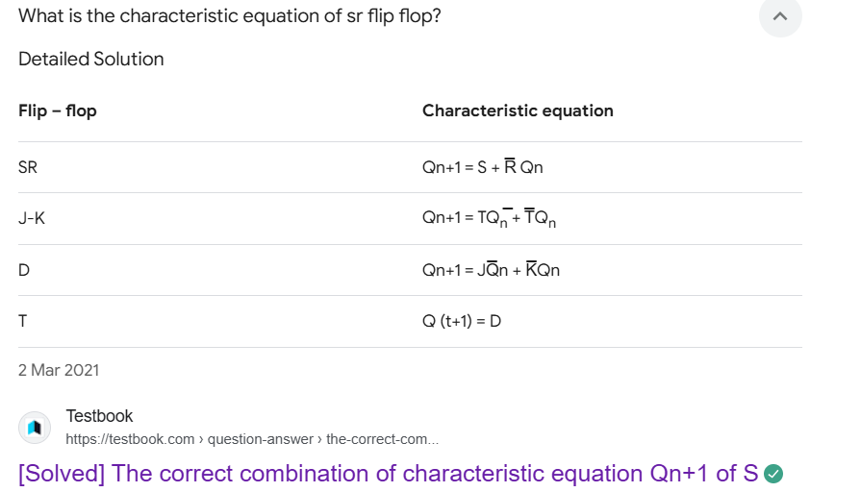

Slide 37
